Slide 1
DataDunkers: Data Science for Everyone!
Heather Shapiro
Technical Evangelist

Slide 2


Slide 3

Science Technology Engineering Math

Slide 4

Careers in STEM

Slide 5
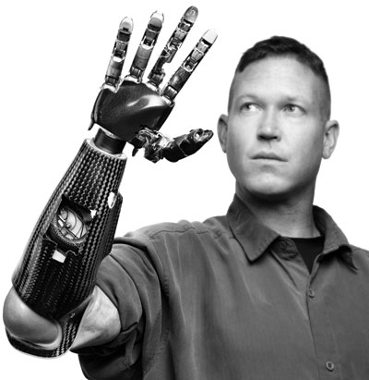

Slide 6


Slide 7


Slide 8
“I keep saying the sexy job in the next ten years will be statisticians. People think I'm joking, but who would've guessed that computer engineers would've been the sexy job of the 1990s?” - Hal Varian , Chief Economist at Google

Slide 9
What is data science?

Slide 10


Slide 11


Slide 12

Notes:
Goal: Teaching Data Science and Inspire
Call to Action: Journal, Project, Azure and Dreamspark Usage ( WordPress/ AzureML)
Results: DreamSpark usage/ activation, ImagineCup Participation, stories

Slide 13
A combination of mathematical techniques and algorithmic approaches to understand the world around us in order to solve complex problems.

Slide 14
What can we do with it?
We can take data
to be able to understand it
to process it
to extract value from it
to visualize it

Slide 15
Approach like a Science problem
Identify the problem/question
Do background research
Hypothesize what will happen
Test your hypothesis
Analyze your data
Draw a conclusion
Communicate your results

Slide 16
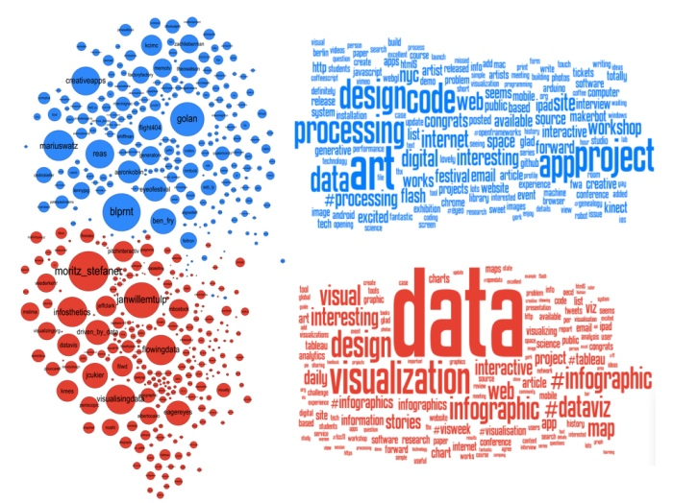

Slide 17
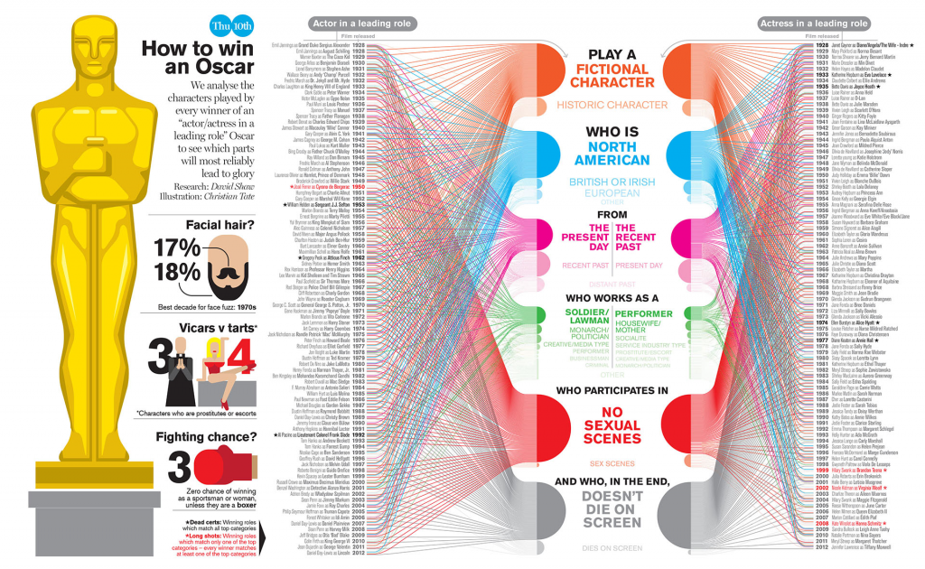

Slide 18
How can we relate math?

Slide 19
Independent and Dependent Variables

Slide 20
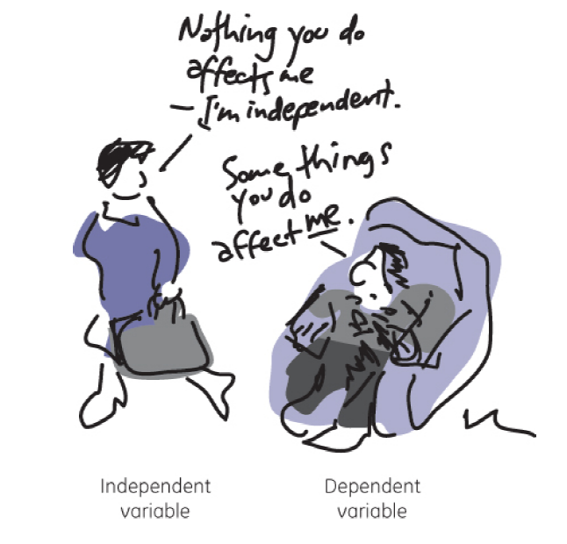

Slide 21
What are some examples?

Slide 22
Mean, Median, Mode

Slide 23
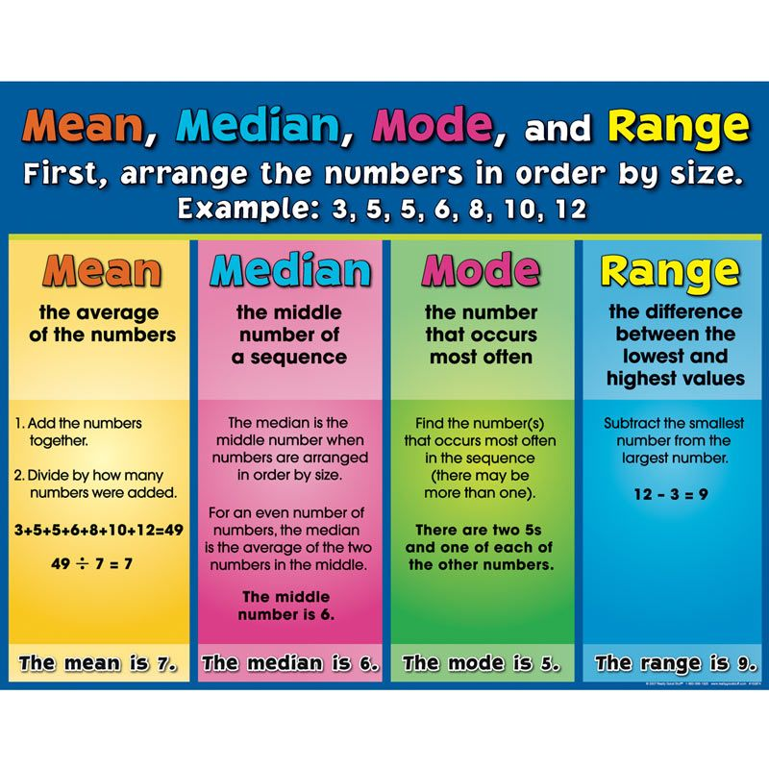

Slide 24
Thanks!

